Slide 1

Final Project – Jithendra Seneviratne
An Exploration of Collaborative Filtering Model Performance Based on Sparsity, Learning Weights and Rating Variance.

Slide 2
Data:
Beer Recommender Data: https://snap.stanford.edu/data/web-BeerAdvocate.html
Jester dataset: http://eigentaste.berkeley.edu/about.html
Objectives:
Use cloud computing for efficiency
Check sparsity of both datasets
Look at ideal number of weights for different datasets using Apache Spark
Use different models in the Surprise package to decide ideal algorithm (using RMSE)
Compare model performance with levels of sparsity
Fabricate user (myself) and see predictions on my ratings (using different models)
Look at performance metrics other than RMSE by tuning the minimum number of ratings (manipulating sparsity)

Slide 3
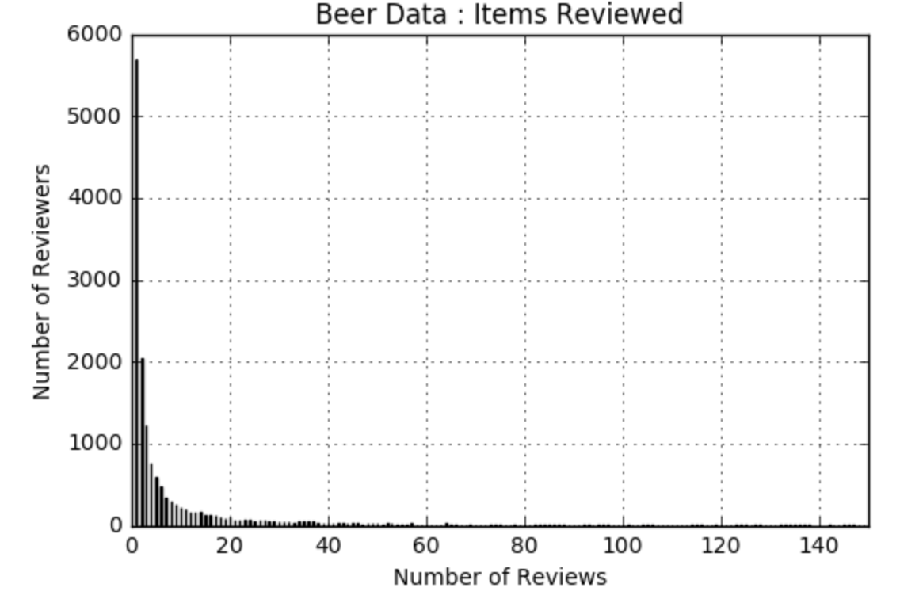
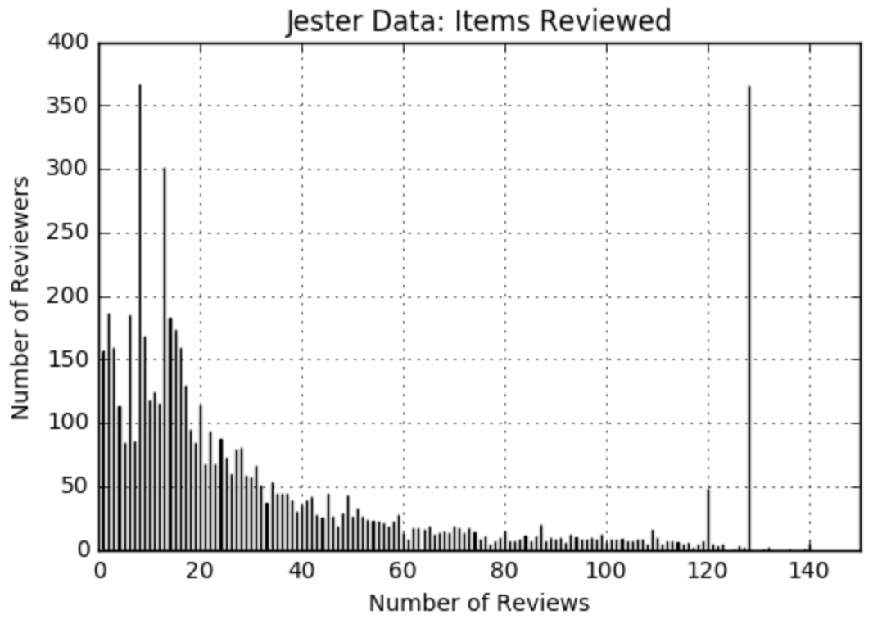
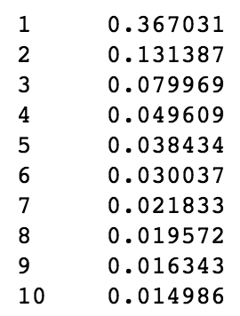
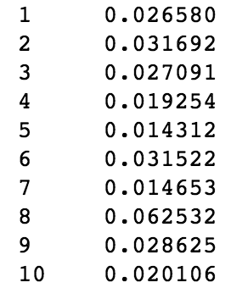
Distribution of Beer And Jester Rating Counts (Exploring Sparsity)
# of Ratings
Fraction of Beers
# of Ratings
Fraction of Jokes

Slide 4
Determining Weights for Different Levels of Sparsity using Spark
Beer Advocate Data
From a previous exercise, we know that that 10 weights worked better than a higher number for the Beer Advocate Dataset. This dataset was moderately sparse, with 36% reviewing only one item
Jester and Book Review Data
Using Distributed computing power, we determined the ideal number of weights for both the Jester review dataset.
Book Review Data: Most Sparse: 44% only reviewed one item
Jester Data: 2% reviewed one item
For both datasets, 10 weights yielded a lower RMSE than a higher number

Slide 5
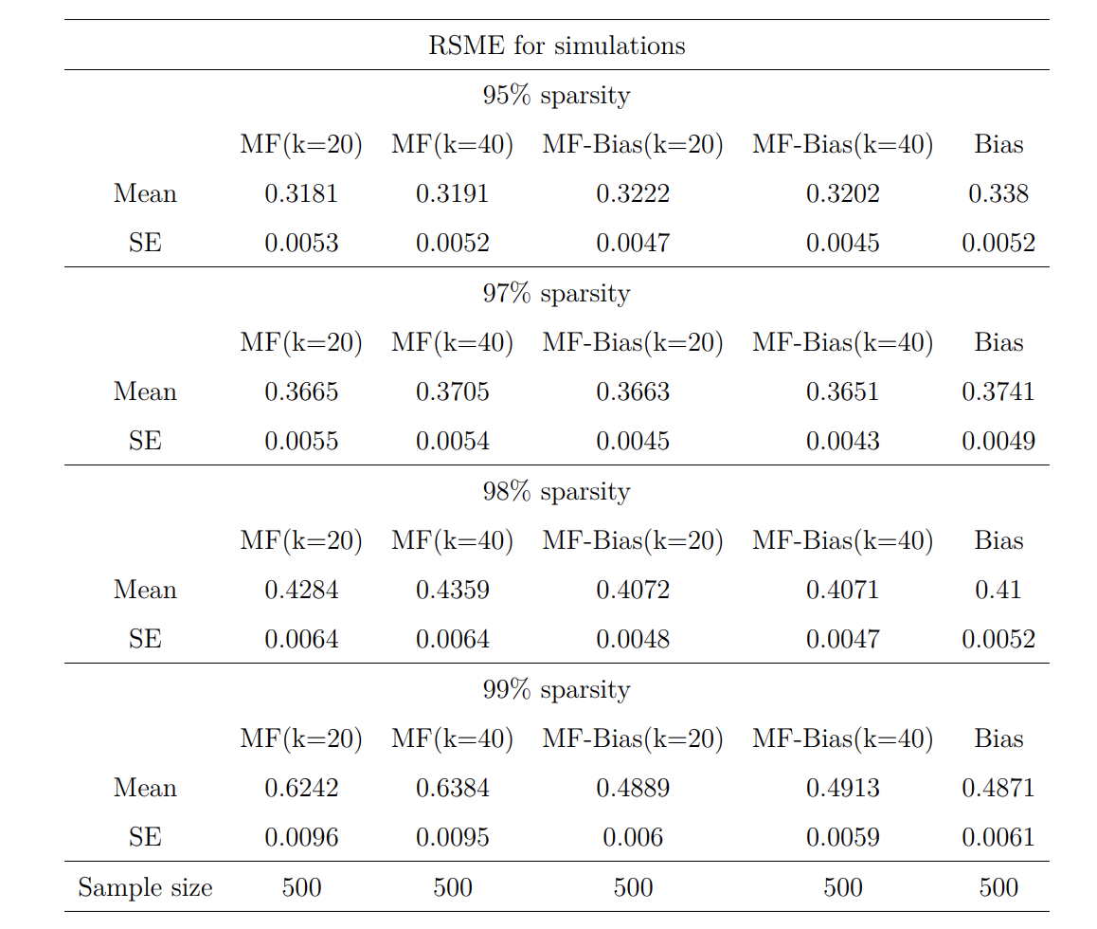
Matrix factorization in recommender systems
How sensitive are matrix factorization models to sparsity?
By Zakris Strömqvist

Slide 6
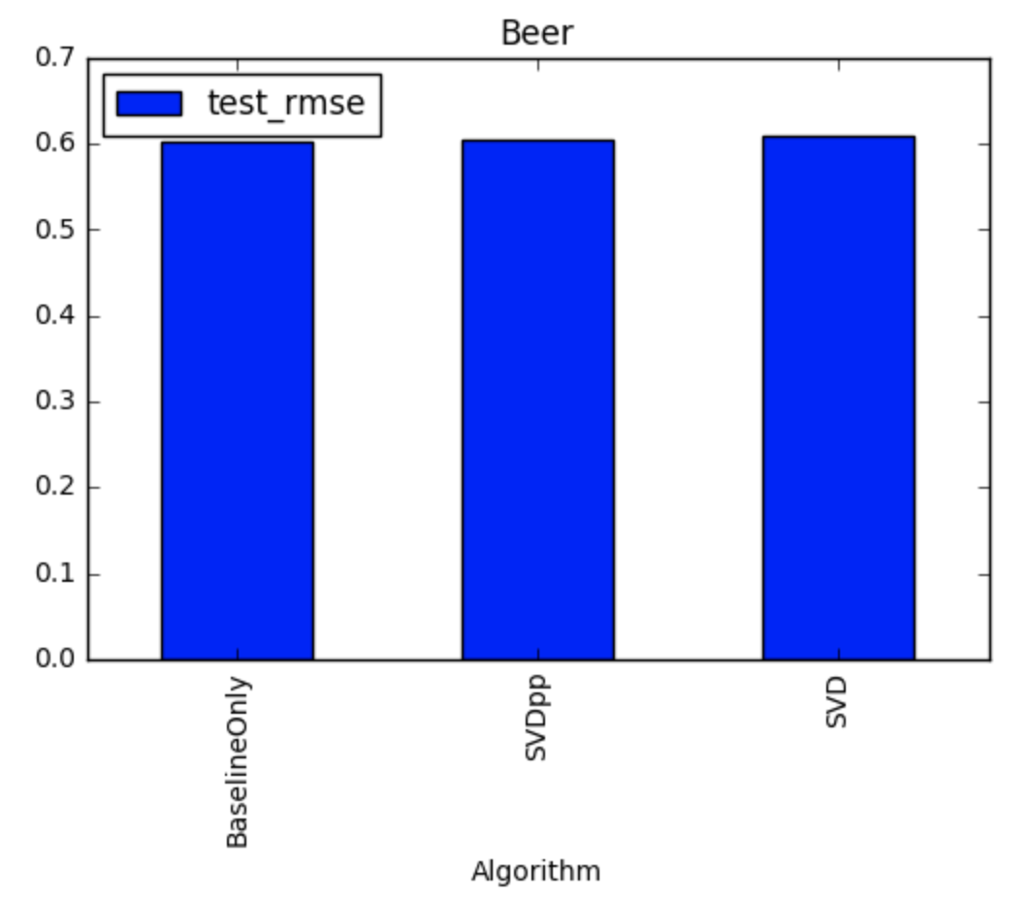
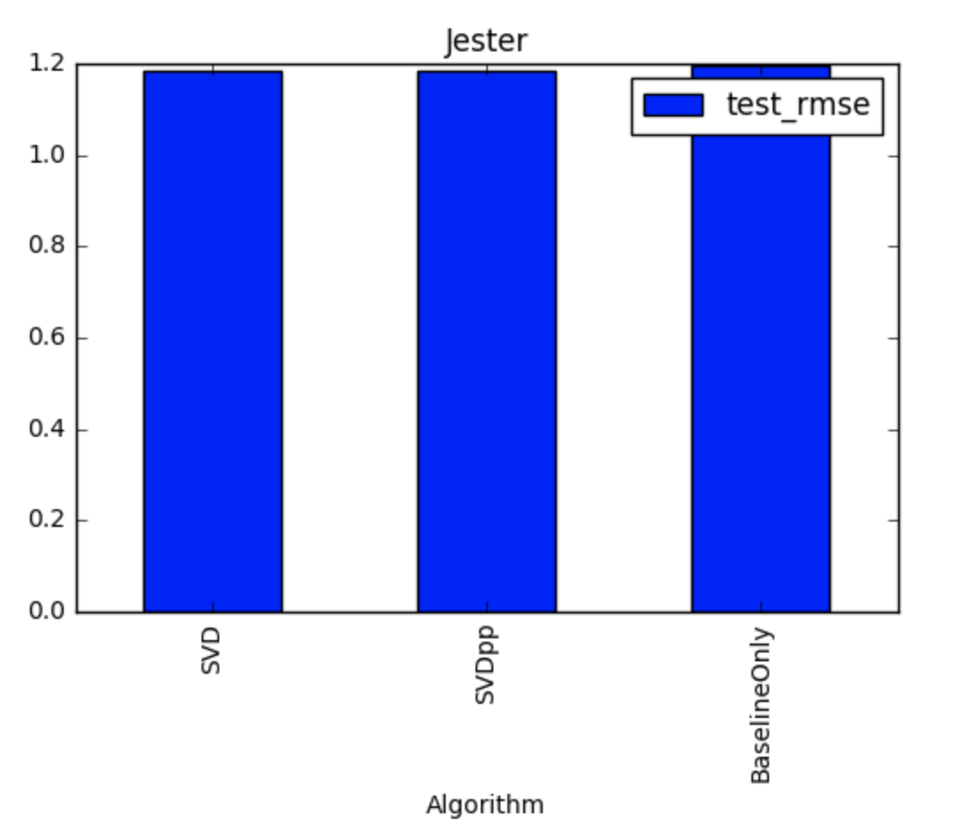
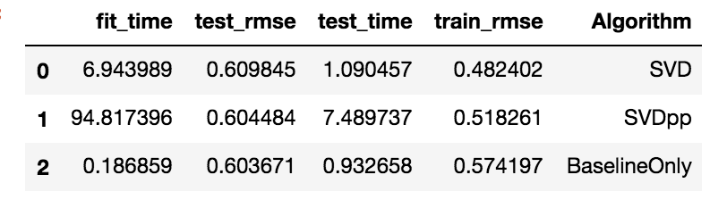
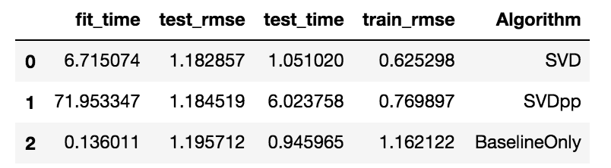
For some reason, even though the Jester data is the less sparse, the SVD model is performing better than the Baseline model.
Predictably , the Baseline model for the Beer Advocate dataset performs best.

Slide 7
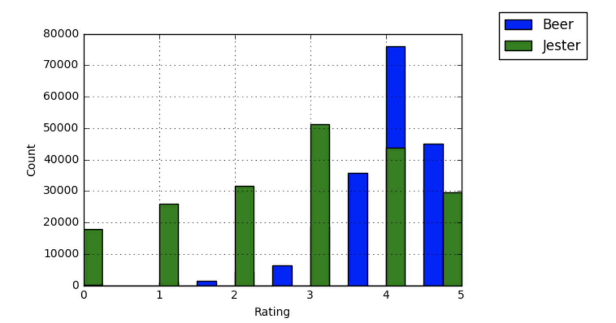
Distribution of Beer Ratings and Jester Ratings
Standard Deviation for Jester Ratings: 1.5025
Standard Deviation for Beer Ratings: 0.693

Slide 8
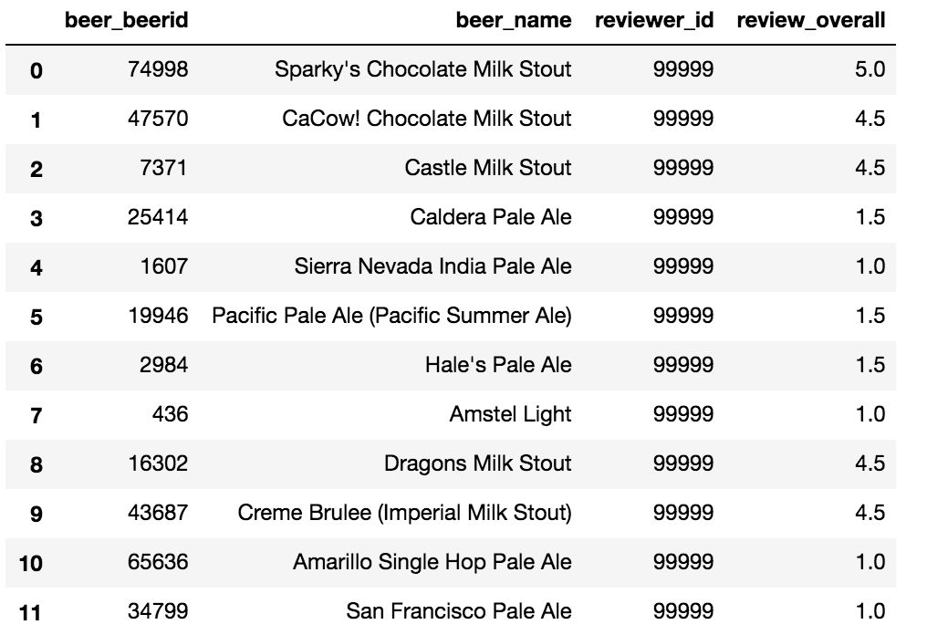
Testing My Reviews
Training Set
I have evaluated both Stouts and pale ales. Incidentally I don’t like pale ales, so I have rated them poorly, and the opposite for stouts. Hopefully the model will pick up the fact that I am a fan of stouts

Slide 9
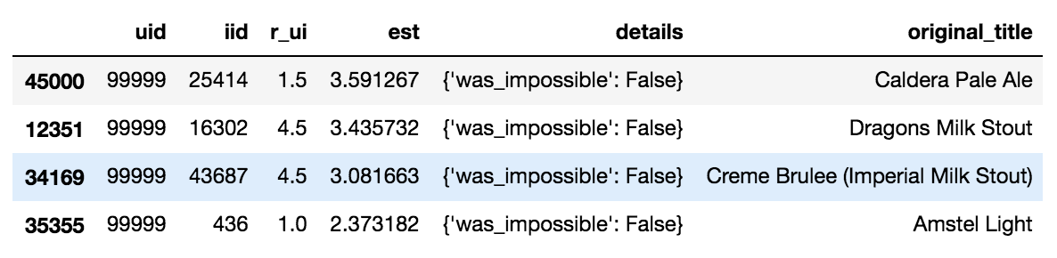
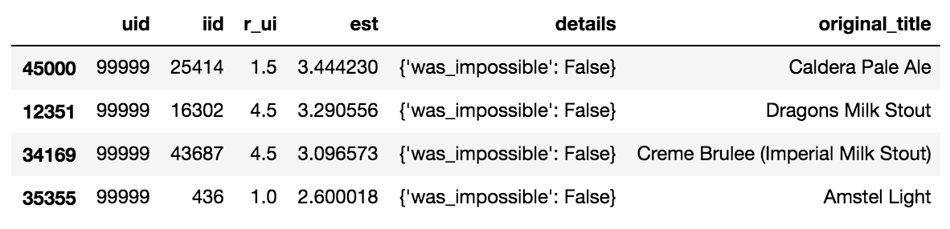
SVDpp Test Results
The results seem very ‘middle-of-the-road’
Baseline Only Test Results
We haven’t done much better with the baseline model

Slide 10
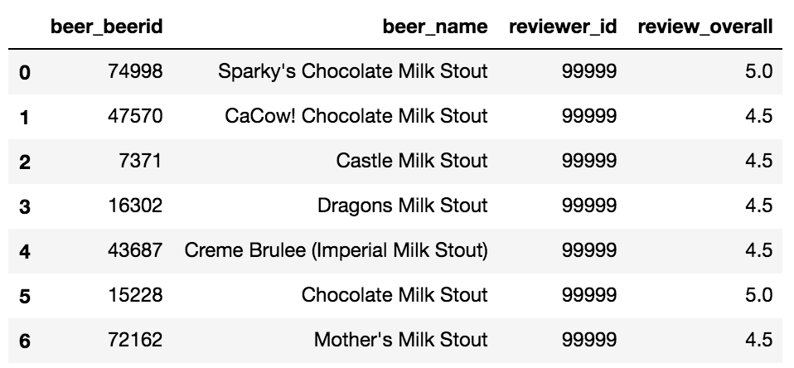
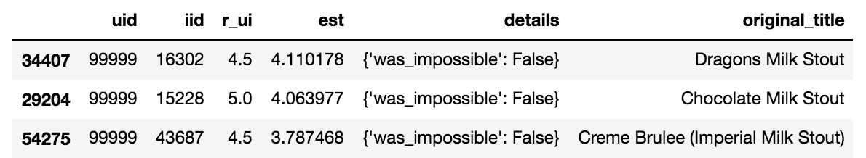
Rating Only Stouts

Slide 11
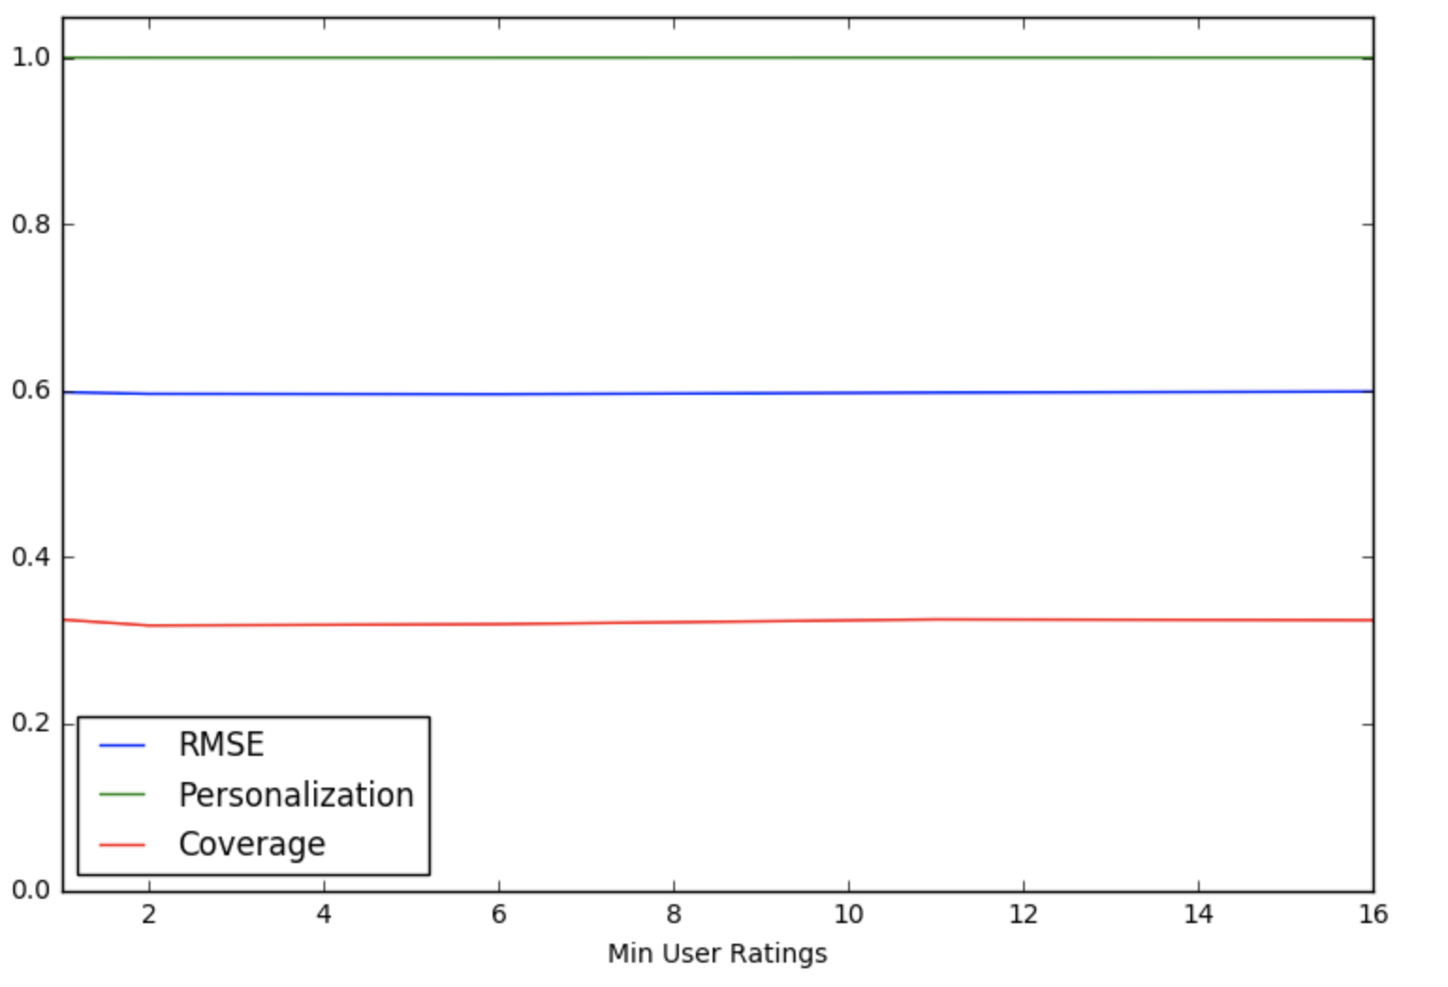
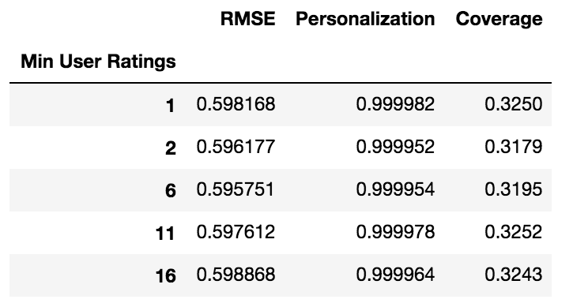
Personalization and Coverage

Slide 12
Summary
Sparsity affects our models but so does variance of ratings. Since our Beer data had low variance, the RMSE was naturally lower, irrespective of the model. The Baseline model did not seem to do well with high variance.
All models seemed to be influenced by the fact that (apparently) those who liked pale ales also enjoyed stouts!
Finally we can tell that a fewer number of weights (10) is better than a higher number (20)

